Slide 1
Natural Language Processing for Assessing Job Applicants
Tim Sparer

Slide 2
Project Goal
Can NLP improve the job application process?
Notes:
More specifically, can I use NLP to improve the recruiting pipeline and interview process by (partially) automating the evaluation of candidates. More specifics shortly.

Slide 3
Motivation
1. “Bad hires” can cost up to 70,000 in lost productivity (source: Hire Abby).
Recruiters’ time and resources are limited.
Sensible quantitative metrics are often lacking for broad skillsets, qualities etc.

Slide 4
Motivation
1. “Bad hires” can cost up to 70,000 in lost productivity (source: Hire Abby).
Recruiters’ time and resources are limited.
Sensible quantitative metrics are often lacking for broad skillsets, qualities etc.
Example: How do you measure “Handles Conflict Well”?
Notes:
A traditional ways of answering question 3 are behavioral interviews… (See point 2)

Slide 5
Proposed Solution
Train a classification algorithm on interview data, and see if the algorithm mimics recruiters’ evaluations.
Notes:
Thus Saves the recruiter time:
Note that we use interview information, not resumes because resumes are sparse…

Slide 6
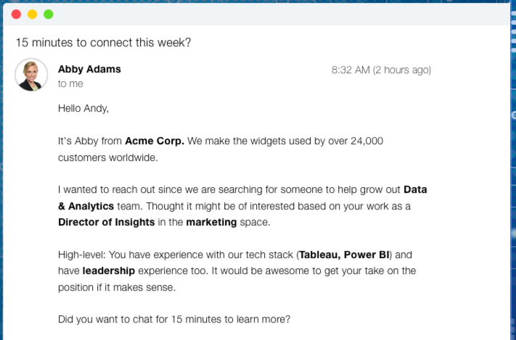
Data
Applicant replies to chatbot-conversations (+evaluations)
Notes:
Here’s what the chatbot looks like

Slide 7
Sample Question + Reply
Bot: Tell me about the most complex software project you have worked on.
Human: "In terms of complexity, I would have to say the Reimbursement Site I've recently completed as a training project. It had over a dozen Java files, nearly a dozen HTML pages, and several AJAX methods, along with a simple SQL database. It implemented front-end pages using HTML, JavaScript, and most notably AJAX calls to tie it with the rest of the program. It passed or requested any info to/from one of two servlets, one to update the SQL database and one to retrieve a query result. Both pass the info to a single request helper, which redirected the calls to an appropriate controller. These controllers called DAO methods that accessed the database and retrieved/altered the data as need be. The database consisted of two tables, one sequence, and one procedure to add new values to the second table."
Notes:
Note in these chatbots, the questions are often structured as behavioral or narrative types of interview questions. (Were hot for a while, decent evidence base, but now people are a bit more iffy on them) – from an NLP standpoint these are helpful, however, because they tend to be richer than either info on a resume, OR simple form responses (such as forced choice, likert type etc). But they are also harder to analyze because of they are more complex.
Before I get on to the analysis a little bit more about the structure of the data, posed some interesting challenges but also offers opportunities-

Slide 8
Structure of the data
Software + Analytics
Data Engineer
Data Scientist
Civis: position
DataScience for Social Good: position
Project Manager
Interview: Fahad Score: 1
Interview: Martin Shkrelli Score: 0
Industry
Job Types
Company+Position
Interviews
Notes:
Which meant that unfortunately the data was/is a bit more sparse than it originally appeared.
But it also means the feature space for per position will be different: For example- A software engineer will answer the question, “Tell me about a time you handled a conflict well”, differently from a customer service rep

Slide 9
Structure of the data
Software + Analytics
Data Engineer
Data Scientist
Civis: position
DataScience for Social Good: position
Project Manager
Interview: Fahad Score: 1
Interview: Martin Shkrelli Score: 0
Industry
Job Types
Company+Position
For the analysis:
selected a collection of
interviews across candidates for the
same position in the same organization.
Interviews
Notes:
Which meant that unfortunately the data was/is a bit more sparse than it originally appeared.

Slide 10
Process
Interivew Data
Extract Context (Using word2vec)
Feature Selection (PCA)
Classification:
Should this applicant be forwarded to the recruiter?)
Notes:
To do the classification used an SVM

Slide 11
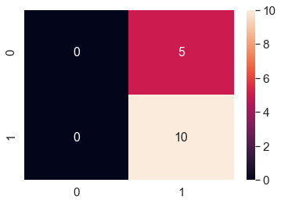
Confusion Matrix: Predicted Approval vs. Actual Approval (approve = 1, not approve = 0) Accuracy = 66%
Number of samples
in cell
Predicted Value:
Actual Value

Slide 12
Next Steps:
Tune thresh-holds.
Try additional classifiers
Supplement data
Explanatory models: For a given model/interview, are particular questions more diagnostic (more predictive?)

Slide 13
Next Steps:
Tune thresh-holds.
Try additional classifiers
Supplement data (example, CoSine similarity between the interview of an “ideal” candidated, or previous hire, and a given interview).
Explanatory models: For a given model/interview, are particular questions more diagnostic (more predictive?)

